Slide 1


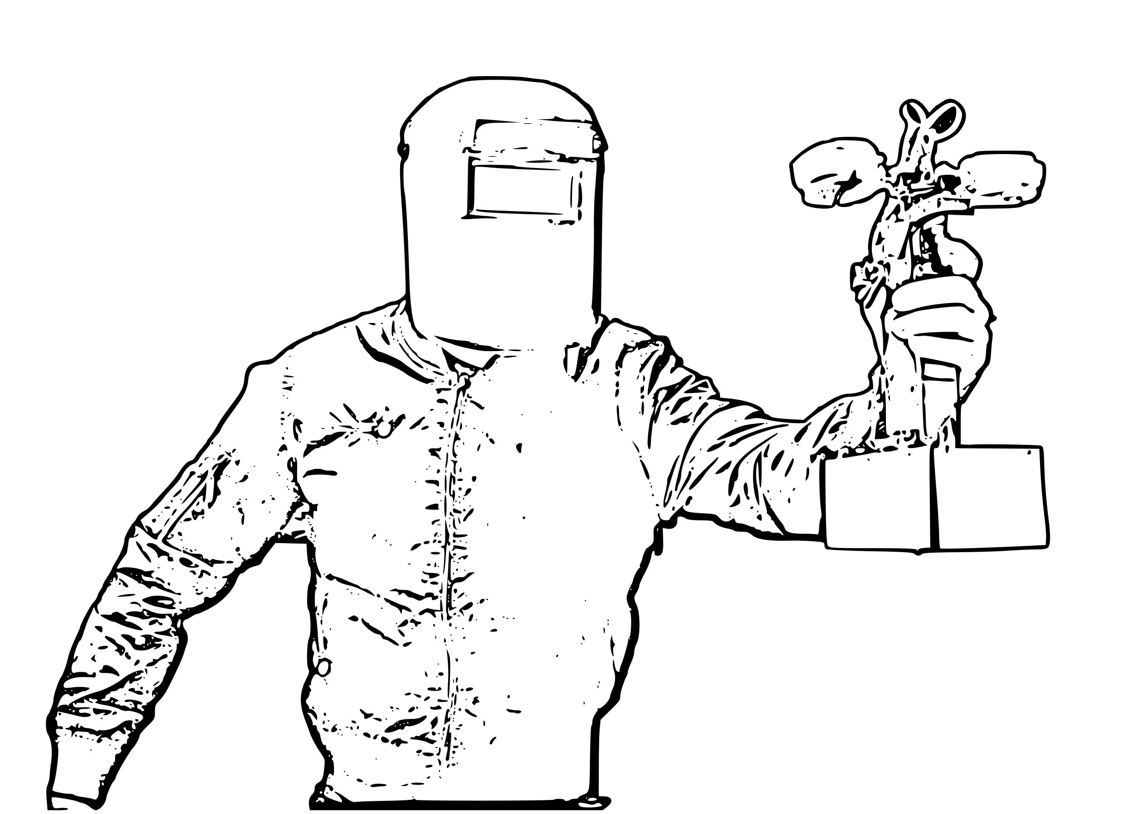
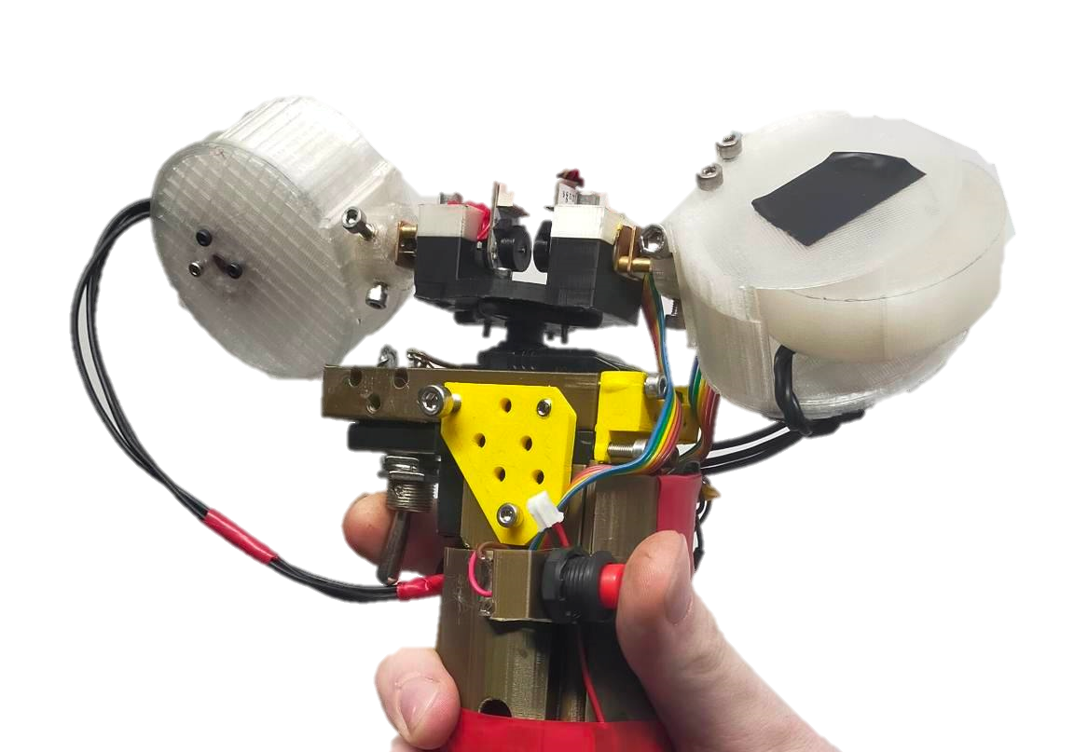
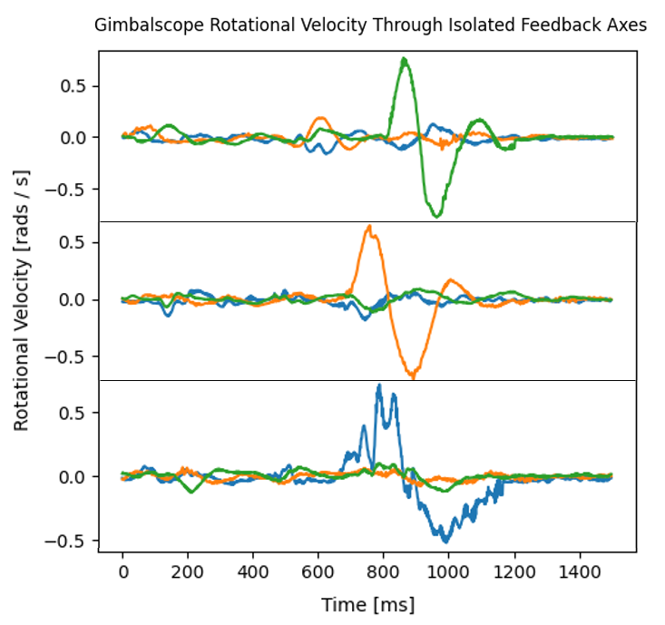

GIMBALSCOPE:
SPACECRAFT ATTITUDE CONTROL FOR HAPTIC FEEDBACK.
University of Bristol, Department of Computer Science
A Dual Parallel Gimbal Controlled Moment Gyroscope for Ungrounded Directional Force Feedback.
Jordan Taylor Supervisor: Anne Roudaut
The key problem with current force feedback haptic devices is balancing the three-way trade-off between form-factor, the workspace of interaction, and force fidelity. The Gimbalscope attempts to maximise the first two points while not sacrificing the third.
We present the first remotely operated ungrounded general purpose directional haptic feedback device powered by gyroscopic precession.
Traditionally, Controlled Moment Gyroscopes (CMGs) are devices used for attitude control and stabilization in spacecraft and satellites. They work by using a spinning mass (gyroscope) that can be oriented in any direction, and by controlling the angular momentum of the spinning mass, it can create a torque to control the orientation of the spacecraft.
torque axis
gimbal axis
Induction of a Backwards Torque
My work involves determining the suitability of such a system on the human scale.
The Gimbalscope allows total workspace freedom for the user, being untethered and battery powered. The dual controlled-moment-gyroscopes allow for six degrees of freedom haptic torque feedback.
A preliminary study of N = 8 participants show that users are able to correctly perceive the device’s haptic cues.
Present research outcomes involve a study of N = 20 participants with the aim of determining the Gimbalscope’s minimum human perception threshold as a function of gyroscope rotational velocity.
Planned further outcomes will make use of the device’s onboard IMU to guide the aim of a cohort of users to a selection of targets.
X
Y
Z
cynical-cheddar.github.io
xz18677@bristol.ac.uk
Isolated Torque Axes for clockwise cues

